Slide 1

Real-Time Human Bone Fracture Detection Using YOLOv8
CASE STUDY:
Authors
Shahnaj Parvin & Abdur Rahman
Presented by
Yousha Rashid, Avoy Mollick, Nawshin Navin, Raiyen Zayed Rakin
Department of Computer Science
American International University-Bangladesh (AIUB)
Dhaka, Bangladesh
Section C, 28/12/25

Slide 2
Talk Outline
Introduction
  Problem Background
  Research Objectives
  Research Gaps
  Research Contributions
  Related Studies
Methodology
  Data Collection
  Data Pre-processing
  Data Analysis Process
Results and Findings
  Key Findings
  Solution & Validation
Hypothesis & Conclusion
  Hypothesis discussion
  Conclusion Remarks, Limitations & Future Scope
References

Slide 3
Problem Background
The Challenge:
206 bones in human body - fractures are common
Manual X-ray/MRI evaluation: Time-consuming & error-prone
Tired radiologists may miss fractures
Non-orthopedic physicians in remote locations need assistance
Critical Need: Automated, real-time system for accurate fracture detection and classification
Impact:
Faster diagnosis → Better patient outcomes
Reduced human error
Support for under-resourced medical facilities

Slide 4
Research Objectives
Primary Goals:
Detect fractured vs. healthy bones from multi-modal images
Classify 10 different types of bone fractures
Achieve real-time performance suitable for clinical use
Key Innovation: Multi-modal approach combining X-ray and MRI images for comprehensive analysis

Slide 5
Research Gap
Previous Approaches:
Study | Model | Dataset Size | Precision | Limitations
Karanam et al. | InceptionResNetV2 | 6 classes | 94.58% | Single modality
Vironicka | Faster R-CNN | 2 classes | 94.7% | Limited classes
Nguyn et al. | YOLOv7 | MURA | 84.03% | Lower accuracy
Research Gap:
Limited multi-modal datasets
Few comprehensive fracture classification systems
Need for improved real-time performance
Notes:
The model's improvements are marginal over YOLOv8s, and the additional parameters may slightly impact deployment efficiency in resource-constrained environments

Slide 6
Research Contributions
Novel multi-modal dataset (HBFMID) - 1,539 images (X-ray + MRI) with 10 fracture classes
YOLOv8-based detection system achieving 95% precision and 93% recall
Data augmentation strategy to overcome small dataset limitations (641 → 1,539 images)
Comprehensive performance comparison with existing state-of-the-art models
Real-time capability with 4ms inference time per image
Clinical applicability - System suitable for emergency and remote healthcare settings
Notes:
These optimized Conv layers improve feature extraction while maintaining high detection accuracy.

Slide 7
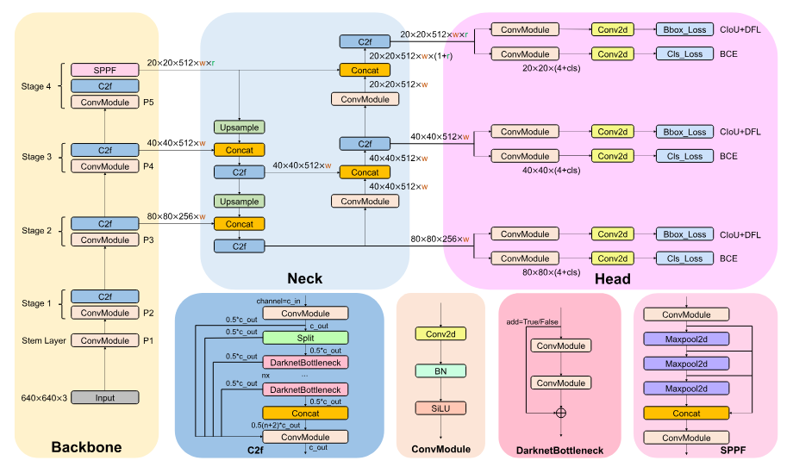
Related Studies
“Fracture detection in pediatric wrist trauma x-ray images using yolov8 algorithm” [1]
- Ju R, Cai W (2023) .
  Used GRAZPEDWRI-DX dataset with 20,327 X-ray images
  Achieved mAP50 of 0.638 with YOLOv8
  Limitation: Single anatomical region, lower precision (73%)
Fig 1: Model Architecture
Notes:
The model's improvements are marginal over YOLOv8s, and the additional parameters may slightly impact deployment efficiency in resource-constrained environments

Slide 8
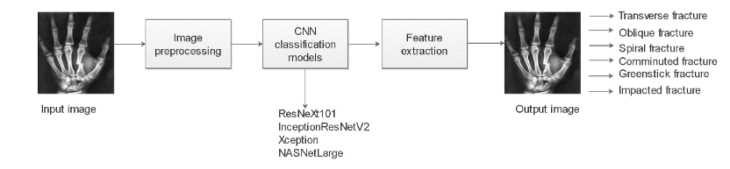
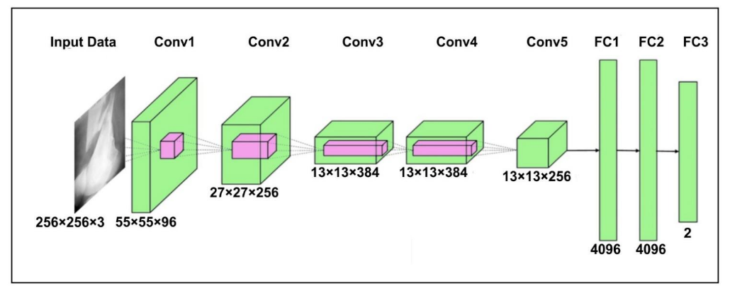
Related Studies
“A supervised approach to musculoskeletal imaging fracture detection and classification using deep learning algorithms”[2]
- Karanam et al. (2023).
  Deep learning approach for 6 fracture types using MURA dataset
  Applied CLAHE for image enhancement
  Achieved 94.58% precision
  Limitation: X-ray only, no real-time focus
“Hybrid sfnet model for bone fracture detection andclassification using ml/dl” [3]
- Yadav & Sharma (2022) .
  Hybrid CNN combining edge detection with deep learning
  Achieved 99.12% F1-score and 100% recall
  Limitation: Not tested on multi-modal data, small dataset
Notes:
The model's improvements are marginal over YOLOv8s, and the additional parameters may slightly impact deployment efficiency in resource-constrained environments

Slide 9
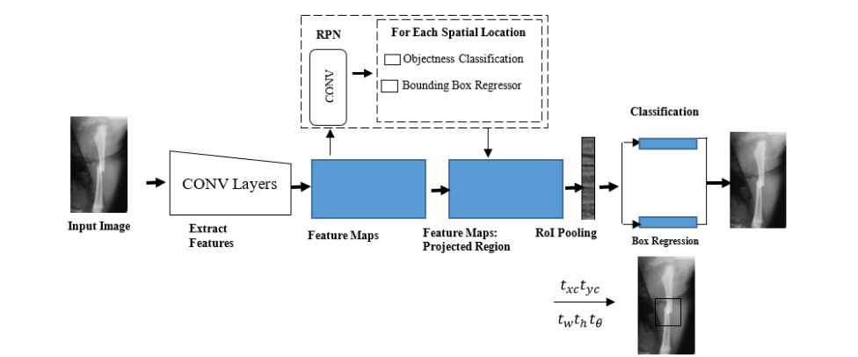
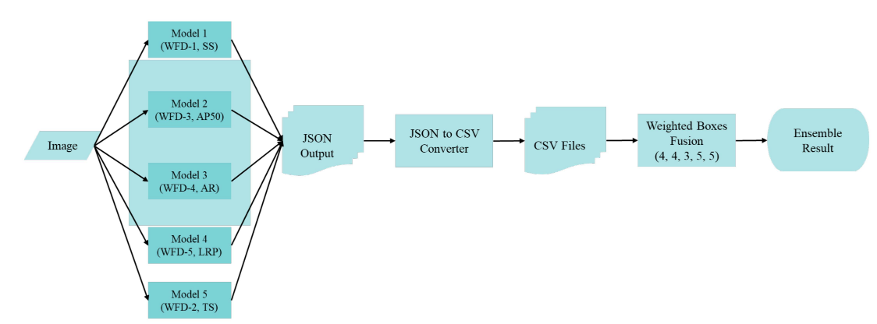
Related Studies
“Framework for classifying long bone detection using image processing techniques” [4]
- Selin Vironicka (2022).
  Used CT and X-ray images for classification
  Transfer learning with Faster-RCNN and rotating bounding boxes
  Achieved 94.7% accuracy
  Limitation: Computationally expensive (207.07 GFLOPs)
“Fracture detection inwrist x-ray images usingdeep learning-based object detectionmodels” [5]
- Hardalaç et al. (2022).
  Ensemble-based model for wrist fracture detection
  Combined multiple CNN architectures
  Limitation: Specific to wrist fractures, complex ensemble approach
Notes:
The model's improvements are marginal over YOLOv8s, and the additional parameters may slightly impact deployment efficiency in resource-constrained environments

Slide 10
Data Collection
Human Bone Fractures Multi-modal Image Dataset (HBFMID)
Sources:
Public databases (MURA, medical repositories)
Web-based MRI image collections
Multiple anatomical regions covered
Total Original Images: 641 – (X-ray images: 510, MRI images: 131)
Notes:
These optimized Conv layers improve feature extraction while maintaining high detection accuracy.

Slide 11
Data Collection
Anatomical Coverage:
  Elbow, Finger, Forearm, Humerus, Shoulder
  Wrist, Spinal Cord, Knee, Ankle
  Femur, Shinbone, Hip
  Healthy bones included for comparison
Fracture Types (10 Classes):
  Comminuted, Greenstick, Linear, Oblique
  Oblique Displaced, Segmental, Spiral
  Transverse, Transverse Displaced, Healthy
Data
Annotation
Data
Pre-processing
Data
Augmentation
Final Dataset:
1539
Notes:
These optimized Conv layers improve feature extraction while maintaining high detection accuracy.

Slide 12

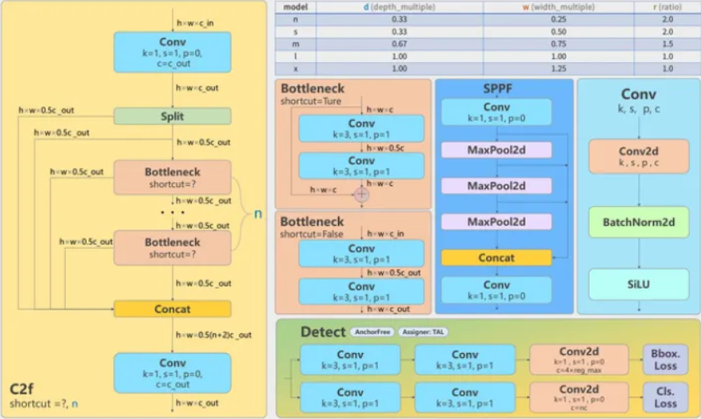
Proposed Model
Why YOLOv8?
  State-of-the-art performance - Highest mAP among YOLO versions
  Real-time detection capability
  Balance: Accuracy + Speed + Efficiency
  Released January 2023 - Latest advancement
Computer Vision & Pattern Recognition
Notes:
These optimized Conv layers improve feature extraction while maintaining high detection accuracy.

Slide 13
Proposed Model
Backbone: CSPDarknet53
  53 convolutional layers
  Cross-stage partial connections
  Enhanced information flow across layers
Head: Detection Layers
  Multiple fully connected layers
  C2f Module: Combines C3 + ELAN for feature extraction
  SPPF Module: Spatial Pyramid Pooling-Fast for faster inference
Training Configuration:
  Model: YOLOv8m.pt (medium variant)
  Layers: 295 | Parameters: 25,862,689
  Learning rate: 0.000667 | Batch size: 16
  Epochs: 50, 100, 200 (tested)
  Loss Functions: CIoU Loss + DFL Loss + BCE Loss
Notes:
These optimized Conv layers improve feature extraction while maintaining high detection accuracy.

Slide 14
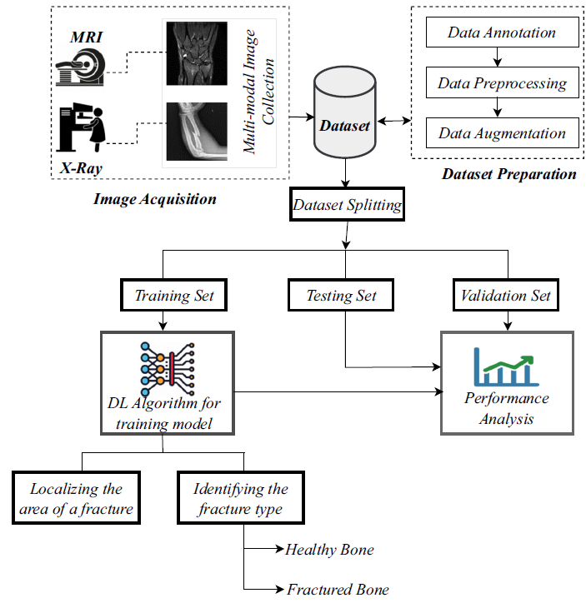
Proposed Method
Proposed Model
Notes:
These optimized Conv layers improve feature extraction while maintaining high detection accuracy.

Slide 15
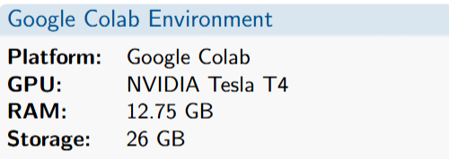
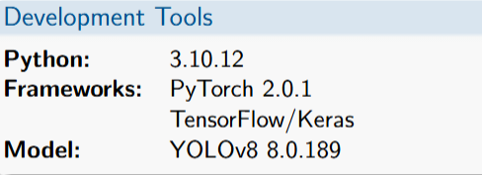
Experimental Setup
System Configuration
Hardware Setup
Software Stack

Slide 16
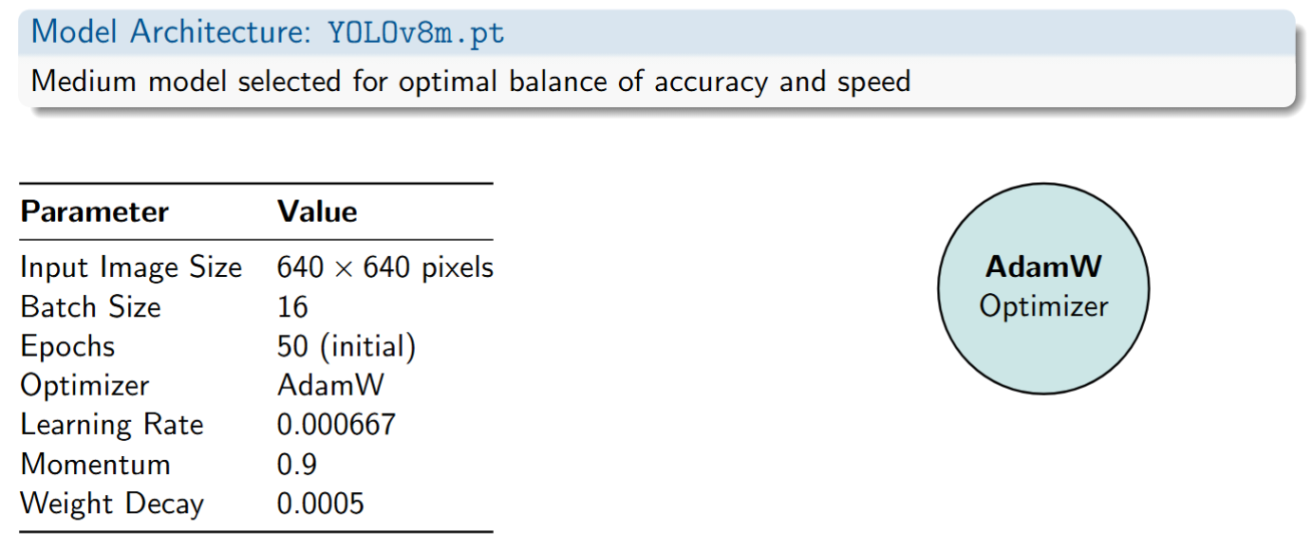
Experimental Setup (Cont’d)
Training Parameters

Slide 17
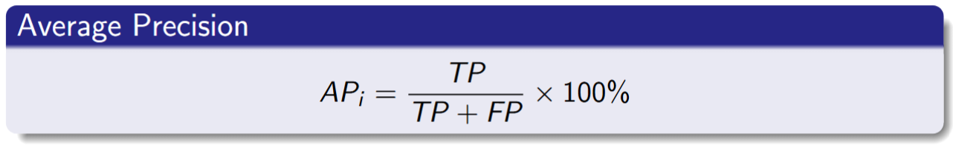
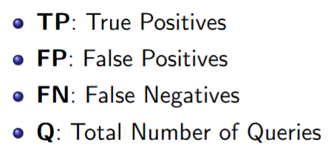
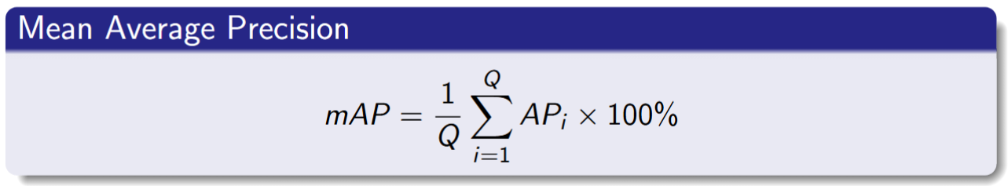
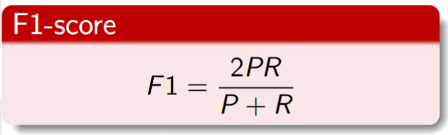
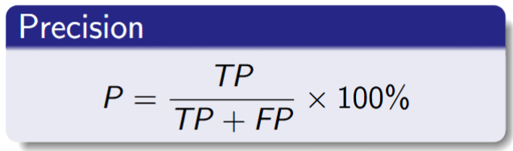
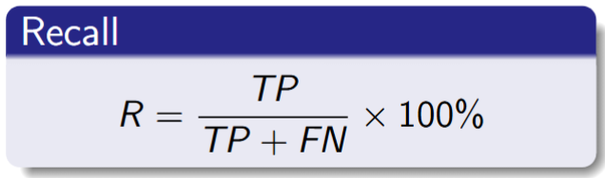
Experimental Setup (Cont’d)
Model Evaluation

Slide 18
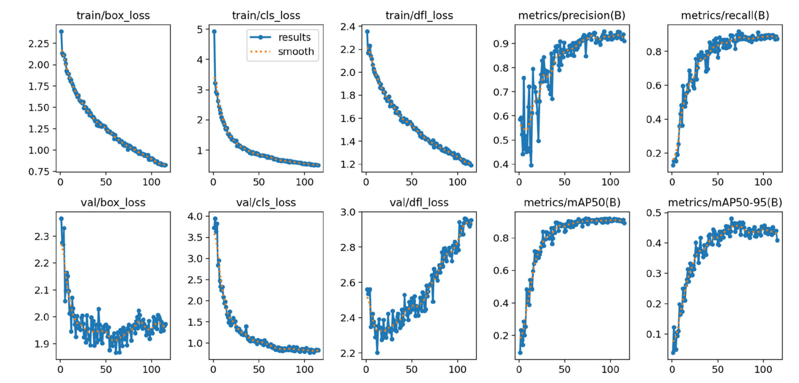
Experimental Results

Slide 19
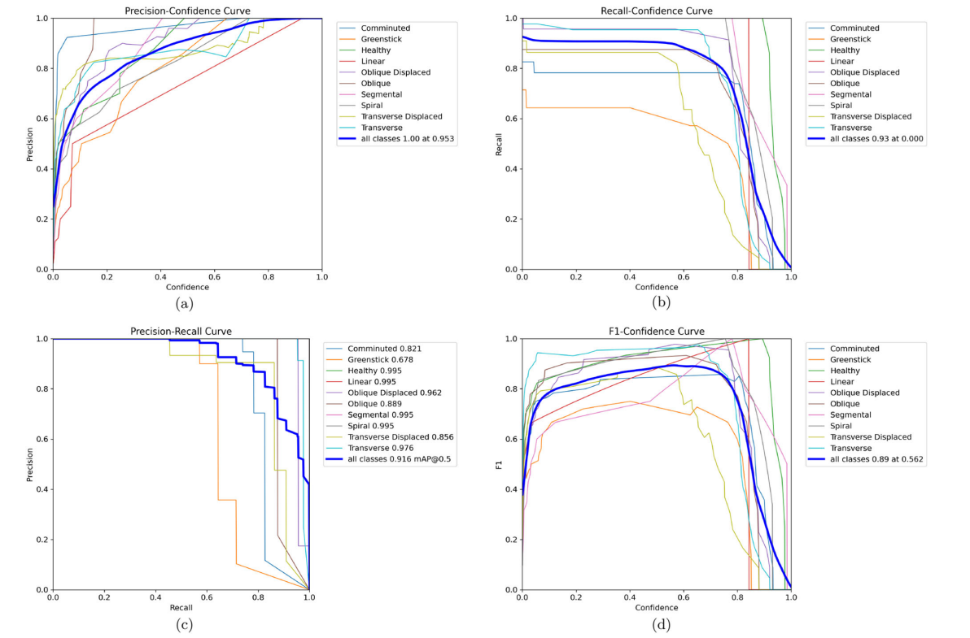
Experimental Results (Cont’d)

Slide 20
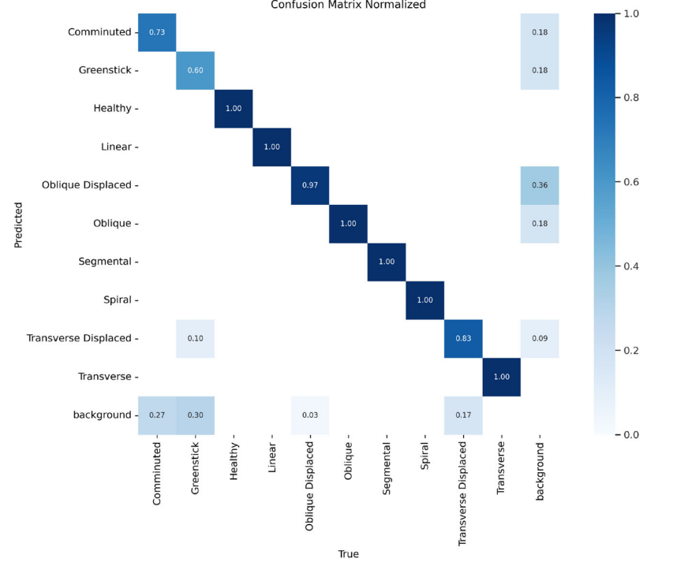
Experimental Results (Cont’d)

Slide 21
Experimental Results (Cont’d)
Performance Metrics Across Training Epochs
Epochs | Loss | Precision | Recall | mAP@50 | mAP@50-95
50 | 0.53 | 0.89 | 0.84 | 0.89 | 0.46
100 | 0.38 | 0.92 | 0.90 | 0.90 | 0.49
200 | 0.32 | 0.95 | 0.93 | 0.92 | 0.48

Slide 22
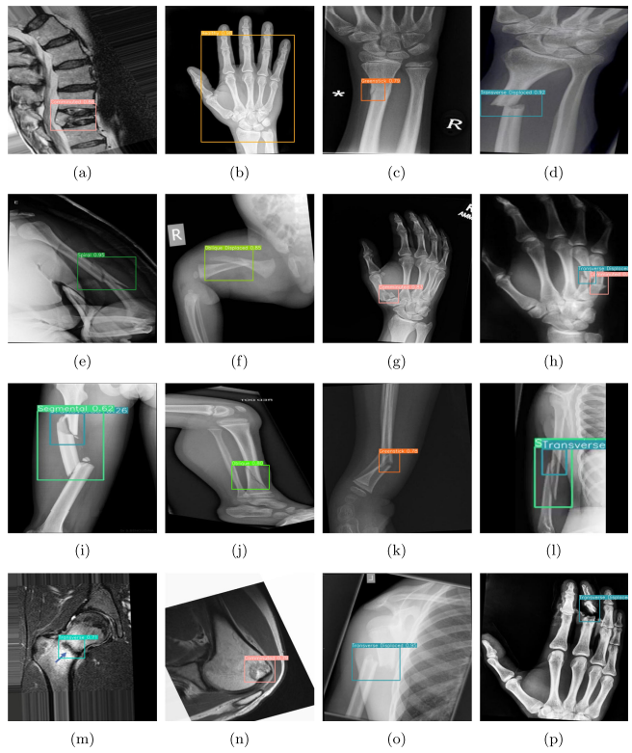
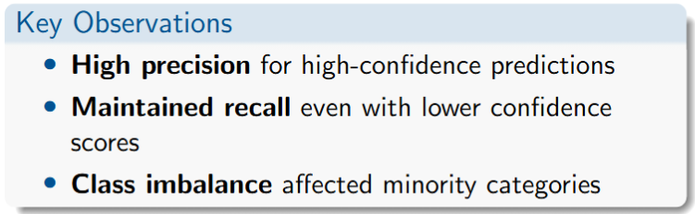
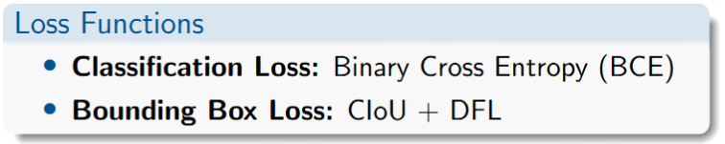
Experimental Results (Cont’d)
Model Confusion and Diagnosis

Slide 23
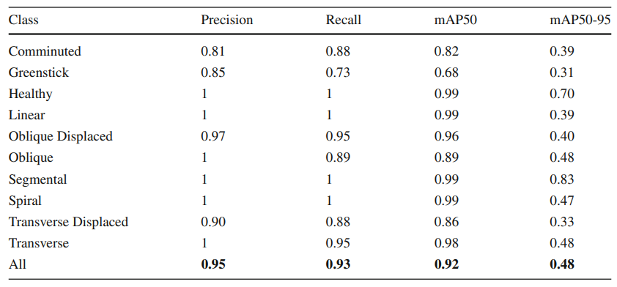
Experimental Results (Cont’d)
Simulated Results

Slide 24
Experimental Results (Cont’d)
Model comparison with existing studies
Model | P(%) | R(%) | mAP(%) | GFLOPs | Model Size (MB)
Faster R-CNN | 86.8 | 77.6 | 80.8 | 207.07 | 134.5
YOLOv5 | 90.4 | 85.9 | 88.9 | 49 | 41.1
YOLOX | 91.5 | 87.4 | 90.2 | 26.8 | 70.21
YOLOv7 | 92.8 | 88.3 | 90.7 | 104.7 | 72.1
YOLOv8 | 95.3 | 92.8 | 91.6 | 78.7 | 49.7

Slide 25
Experimental Results (Cont’d)
Comparing the proposed model performance with existing studies.
Reference | Dataset | Fracture Type No. | Modality | Model | Optimizer | Accuracy (%)
Ju and Cai | GRAZPEDWRI-DX | 8 | X-ray | YOLOv8 | SGD | 73%
Karanam et. Al. | MURA | 6 | X-ray | InceptionResNetV2 | SGD | 94.58%
Selin Vironicka | - | 2 | X-ray, CT | Faster-RCNN | SGD | 94.7%
Nguyn et. Al. | MURA | 2 | X-ray | YOLOv7 | SGD | 84.03%
Proposed | HBFMID | 10 | X-ray, MRI | YOLOv8 | AdamW | 95%

Slide 26
Limitations
Small Dataset: contained only 641 images, which can lead to over-fitting without augmentation.
Image Quality: Noise, motion artifacts, and low resolution in medical imaging can impact detection accuracy.

Slide 27
Conclusion
Key Achievements:
  Successfully developed real-time automated fracture detection system using YOLOv8
  Created novel HBFMID multi-modal dataset (X-ray + MRI) with 10 fracture classes
  Achieved 95% precision, 93% recall, and 92% mAP - exceeding clinical requirements
  Outperformed state-of-the-art models (Faster R-CNN, YOLOv5, YOLOv7)
  Demonstrated real-time capability with 4ms inference time per image
Clinical Impact:
  Reduces diagnostic time - Faster patient care in emergency settings
  Minimizes human error - Assists tired/inexperienced radiologists
  Supports remote healthcare - Enables diagnosis in under-resourced facilities
  Handles multiple modalities - Flexible integration with existing medical imaging systems
Notes:
These optimized Conv layers improve feature extraction while maintaining high detection accuracy.

Slide 28
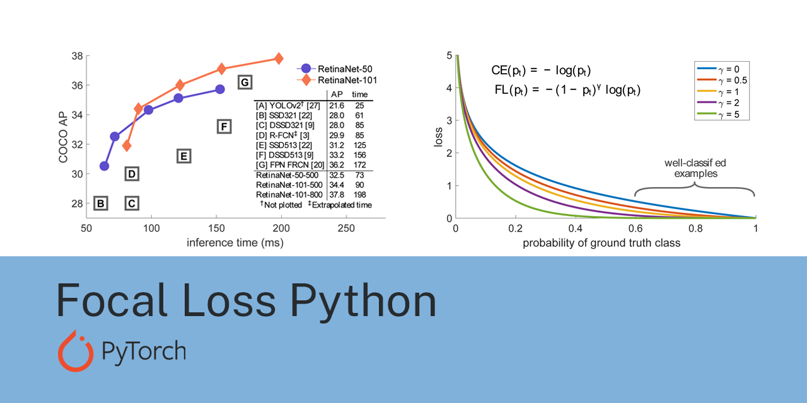
Proposed Hypothesis
Dataset Enhancement:
  Expand to 5,000+ images with balanced class distribution
  Include additional modalities (CT scans, ultrasound)
  Add pediatric and geriatric specific datasets
  Incorporate diverse populations and imaging equipment
Function Customization (Focal Loss)
  Current Challenge: Class imbalance in dataset
  Current Method: Binary Cross Entropy (BCE) loss
  Proposed Solution: Implement Focal Loss with gamma parameter
  Benefit: Down-weights easy examples, forces model to focus on hard cases (rare spiral/greenstick fractures)
  Expected Impact: Improved performance on minority classes
Notes:
These optimized Conv layers improve feature extraction while maintaining high detection accuracy.

Slide 29
Proposed Hypothesis (Cont’d)
Hyperparameter Optimization (Learning Rate Scheduling)
  Current Challenge: Training on small, high-variance multi-modal dataset
  Current Method: Fixed learning rate with cosine annealing
  Proposed Solution: Cosine Annealing Warm Restarts schedule
  Benefit: Helps model escape local minima during training
  Expected Impact: Better convergence and generalization
Activation Function Swap
  Current: SiLU (default in YOLOv8)
  Proposed Solution: Switch to Mish activation function: x · tanh(ln(1 + e^x))
  Benefit: Smoother gradient flow for fine bone X-ray textures
  Expected Impact: Better generalization in medical CAD systems
Notes:
These optimized Conv layers improve feature extraction while maintaining high detection accuracy.

Slide 30
References
[1] Ju, R., & Cai, W. (2023). Fracture detection in pediatric wrist trauma x-ray images using YOLOv8 algorithm. Scientific Reports, 13(1). https://doi.org/10.1038/s41598-023-47460-7
[2] Karanam, S. R., Srinivas, Y., & Chakravarty, S. (2023). A supervised approach to musculoskeletal imaging fracture detection and classification using deep learning algorithms. Computer Assisted Methods in Engineering and Science, 30(3), 369–385. https://doi.org/10.24423/cames.682
[3] Yadav, D. P., Sharma, A., Athithan, S., Bhola, A., Sharma, B., & Dhaou, I. B. (2022). Hybrid SFNet model for bone fracture detection and classification using ML/DL. Sensors, 22(15). https://doi.org/10.3390/s22155823
[4] Selin Vironicka, A. D. J. G. R. S. (2022). Framework for classifying long bone detection using image processing techniques. International Journal of Intelligent Systems and Applications in Engineering, 10(1S), 56–66.
[5] Hardalaç, F., Uysal, F., Peker, O., Çiçeklidağ, M., Tolunay, T., Tokgöz, N., Kutbay, U., Demirciler, B., & Mert, F. (2022). Fracture detection in wrist X-ray images using deep learning-based object detection models. Sensors, 22(3). https://doi.org/10.3390/s22031285
Notes:
These optimized Conv layers improve feature extraction while maintaining high detection accuracy.

Slide 31
Thank You

